Slide 1
Reducing risk of male sex partners: HIV testing, treatment, and VMMC of men in PEPFAR-supported DREAMS districts
Caroline Cooney¹, Kimi Sato², Shannon Allen¹, Nora Toiv¹, D. Heather Watts¹, Janet Saul¹

Slide 2
Cycle of Heterosexual HIV Transmission
Adolescent Girls & Young Women (AGYW) account for about 75% of new HIV infections among adolescents in sub-Saharan Africa
To keep AGYW HIV-free we must also address their male sex partners
Young Adult Men
(5-10 years older than AGYW) with high HIV incidence
HIV
AGYW
(16-23 yrs) at high risk of HIV
Young Adult Women
(24-29 yrs) with high HIV prevalence
Source: CAPRISA (cycle of transmission)

Slide 3
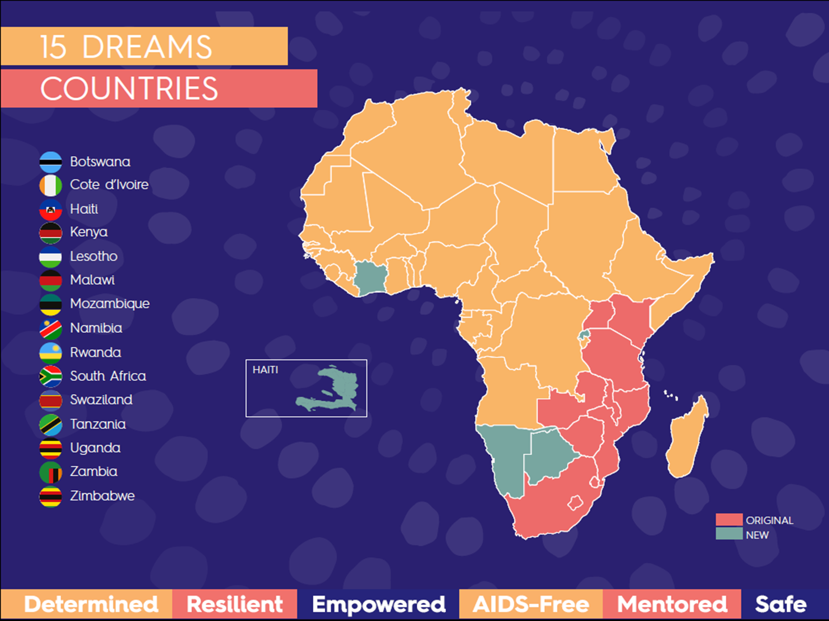
PEPFAR’s DREAMS Partnership
Announced on World AIDS Day 2014
Goal = Reduce HIV incidence of AGYW in DREAMS districts
Total $761 million in 15 countries over 4 years

Slide 4
The Core Package
Empower Girls & Young Women and reduce risk
Mobilize Communities for change
Reduce Risk of Sex Partners
Strengthen Families
Community Mobilization & Norms Change
School-Based
Interventions
Additive Funding VMMC
Parenting/ caregiver Programs
Additive Funding
TX for Men
Characterization of male partners to target highly effective interventions (HTS→ART, VMMC)
Social Protection
(Education Subsidies, Combination
Socio-Economic Approaches)
Youth-friendly sexual and reproductive health care (Condoms, HTC, PrEP, Contraceptive Mix, Post-violence care)
Social Asset Building

Slide 5
Research Question

Slide 6
Was there an increase in HIV testing, circumcision, or treatment uptake in DREAMS vs. comparable non-DREAMS districts after two years of DREAMS implementation?

Slide 7
Methods
Country/District Selection
Of the 10 original DREAMS countries, 5 were chosen for this analysis
PEPFAR districting remained consistent from 2015-2017
Comparable non-DREAMS districts had similar HIV prevalence, incidence, teen pregnancy rates, girls education to DREAMS districts
All PEPFAR priority districts
Analysis of PEPFAR MER Indicators
Number of clients tested (HTS_TST), Number of VMMC procedures (VMMC_CIRC), Number of clients newly initiated on treatment (TX_NEW) for males 15-49 years
Compared annual results from 2015 & 2017, calculated percent change
Used series of generalized linear mixed models, based on a Poisson distribution to assess the difference between DREAMS vs. non-DREAMS districts
Controlled for false discovery rate for multiple hypothesis testing

Slide 8
Results
Significant positive differences (p-value <0.001) between DREAMS vs. non-DREAMS districts
Increase in men newly initiated on treatment = DREAMS > Non-DREAMS in 3 countries
Increase in men tested = DREAMS > Non-DREAMS in 3 countries
Increase in VMMCs performed = DREAMS > Non-DREAMS in 2 countries
Change in VMMC, HTS, and treatment results for men ages 15-49 in DREAMS vs. non-DREAMS districts varied.

Slide 9
Results
Percent Change in DREAMS vs. Non-DREAMS PEPFAR Districts in VMMC, HTS, and Treatment Results for Males Ages 15-49 (2015-2017)
Country | VMMC |  |  | HIV Testing |  |  | New on Treatment
 | DREAMS | Non-DREAMS | Significance | DREAMS | Non-DREAMS | Significance | DREAMS | Non-DREAMS | Significance
Kenya | -11% | -41% | p<0.001 | 123% | 50% | p<0.001 | 1% | 5% | None
Malawi | 23% | -55% | p<0.001 | 99% | -17% | p<0.001 | 21% | -24% | p<0.001
Mozambique | 2% | 77% | p<0.001 | N.D. | N.D. | N.D. | 1739% | 1608% | p<0.001
Zambia | 112% | 16% | p<0.001 | 74% | 86% | p<0.001 | 55% | 50% | None
Zimbabwe | -4% | -11% | p<0.001 | 93% | 78% | p<0.001 | 625% | 310% | p<0.001
N.D. = Not Determined; Mozambique did not report age/sex disaggregated data for HIV testing in 2015.

Slide 10
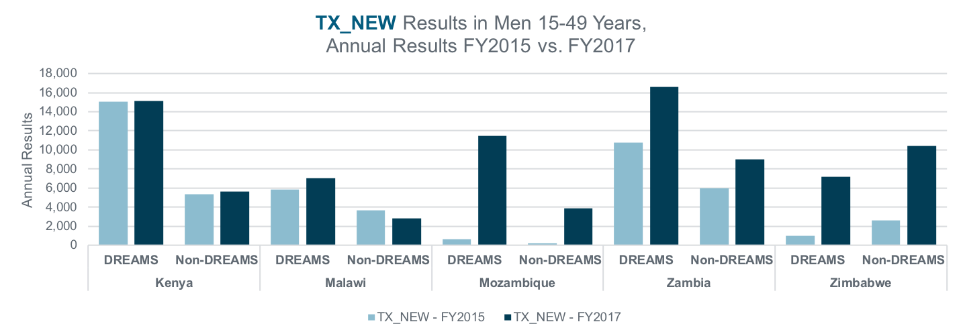
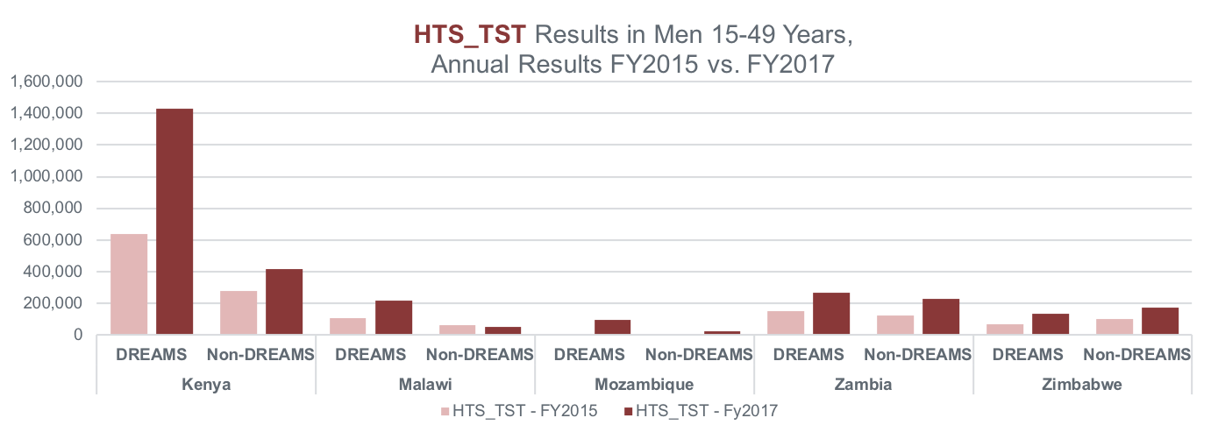

Slide 11
Limitations & Questions for Future Analyses
Limitations:
Results are based on PEPFAR achievement, which does not take into account achievements from national governments and other stakeholders
Differences in overall population between districts
Areas for further analysis:
Qualitative data to contextualize the difference in uptake between countries & districts
Can differences in DREAMS results be explained by differences in testing, circumcision, and treatment coverage of young adult men?

Slide 12
Conclusions
Overall in DREAMS districts, there was an increased uptake in testing and treatment services for men 15-49 years compared to comparable non-DREAMS districts.
We need to reach more men & the right men with HTS, VMMC, and Tx. The wholistic approach of DREAMS is associated with increased uptake of these services.
BREAKING THE TRANSMISSION CYCLE
The variation in results emphasizes the need for continued efforts to reach AGYW and young adult men with multi-sectoral interventions that address their complex needs, lives, and vulnerabilities.

Slide 13
Acknowledgements
Authors:
Caroline Cooney¹, Kimi Sato², Shannon Allen¹, Nora Toiv¹, D. Heather Watts¹, Janet Saul¹
Affiliations:
U.S. Department of State, Office of the U.S. Global AIDS Coordinator & Global Health Diplomacy, Washington, D.C.
Peace Corps, Washington, D.C.
Additional thank you to Imran Mujawar, CDC Atlanta

Slide 14
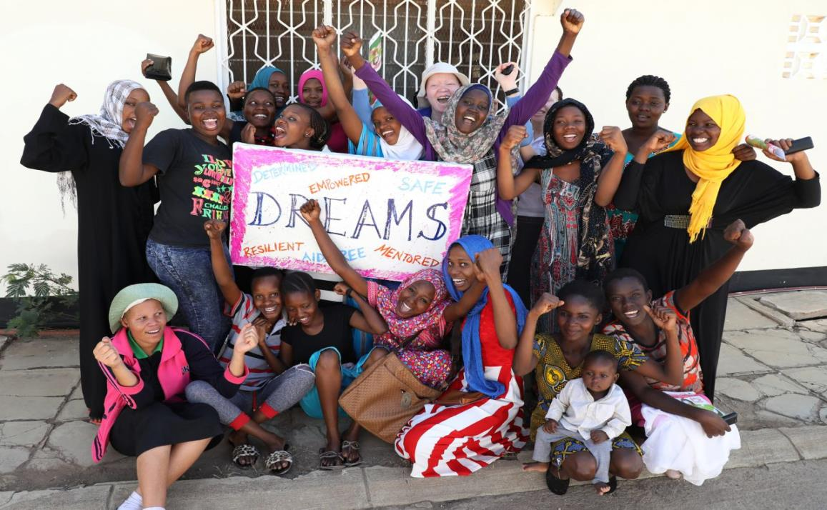
Thank You!

